Slide 1
Facial Expression Recognition
Monica De La Torre, Schehrbano Khan, Kent Lum
May 18, 2019

Slide 2
Agenda
Problem and Uses
Data Review/Cleaning/Transformation
Data Analysis/Modeling/Description/Prediction
Conclusion
Requirements
References
Appendix
Questions

Slide 3
Problem Statement- Deep Learning for Facial Emotions using Convolutional Neural Network
Facial expressions can be useful for:
Marketing campaigns to get first impressions
Medical purposes such as pain indication
Other instances where user interaction or response is necessary

Slide 4
Learning Facial Expressions
Train our application to recognize 4 common emotions
Angry
Neutral
Happiness
Sad

Slide 5
Data Set
Training/Validation Set - Muxspace Facial Expressions
Unprocessed Images
Used built in train_test_split function
https://github.com/muxspace/facial_expressions

Slide 6
Data Review/Validation
Initial data set contained 14190 images with 8 different expression labels
Anger
Surprise
Disgust
Fear
Neutral
Happiness
Sad
Contempt
The image sizes had a wide range but most were 350X350 pixels
The labels were in uppercase and lowercase
Labels were duplicated (Sad, SAD, SADNESS, Sadness)

Slide 7
Data Munging/Cleaning
The team decided to focus on 4 expressions and remove some of the complicated expressions and make the ‘learning’ easier
The team excluded ~1300 images that were not the desired size of 350 X 350 pixels
A new file of uniform image sizes 350 by 350 was created rather than padding images
All the text was put in lowercase

Slide 8
Data Munging/Cleaning - con’t
Training/Validation Set - Muxspace Facial Expressions
Original data set = 3 columns by 14190 rows
Removed irrelevant expressions= 13530 rows
Reduce images based on pixel size = 12823 rows
Augmented * 6 = 76938 total images
75% train and 25% test (57703 and 19234)

Slide 9

Data Augmentation
The transformation was done to the array of the original image. Performed 5 transformations to each image and increased the size of our dataset prior to feeding it to the model.

Slide 10
Data Analysis
The Jupyter Notebook is located here: https://github.com/schehrbanokhan/emotion_recognition_neural_network
Notes:
A positive point is that many different students classified/labeled the images. This helps to get many perspectives

Slide 11
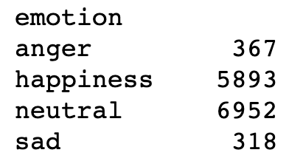
Data Analysis
The original data was imbalanced.
2.7%
43.6%
51.4%
2.3%
Notes:
A positive point is that many different students classified/labeled the images. This helps to get many perspectives

Slide 12
CNN Model Description - Keras Conv2D
Hyperparameters
Stride = 1(default)
Padding = Same (produce and output the same size as the input)
Pooling = 2x2 window (reduces the input by half)
Batch size = 32
Epochs = 14
Model Summary
Total params: 222,702
Trainable params: 222,702
Non-trainable params: 0

Slide 13
CNN Model Description - Keras Conv2D
Sequential Model with 6 Convolutional Hidden Layers
Filter size = 3x3
Activation Layer = RELU (introduces non-linearity to the model)
Dropout Layer = 25% (neurons are ignored during training, prevent overfit)
Inputs Images are 350x350 pixels, 1 channel (grayscale image)
Number of filters starts at 2 and doubles at each hidden layer for a final filter count of 64.
Flatten Layer - Creates the input layer for the artificial network.
Dense Layer - Fully connected layer, each input node is connected to each output node.

Slide 14
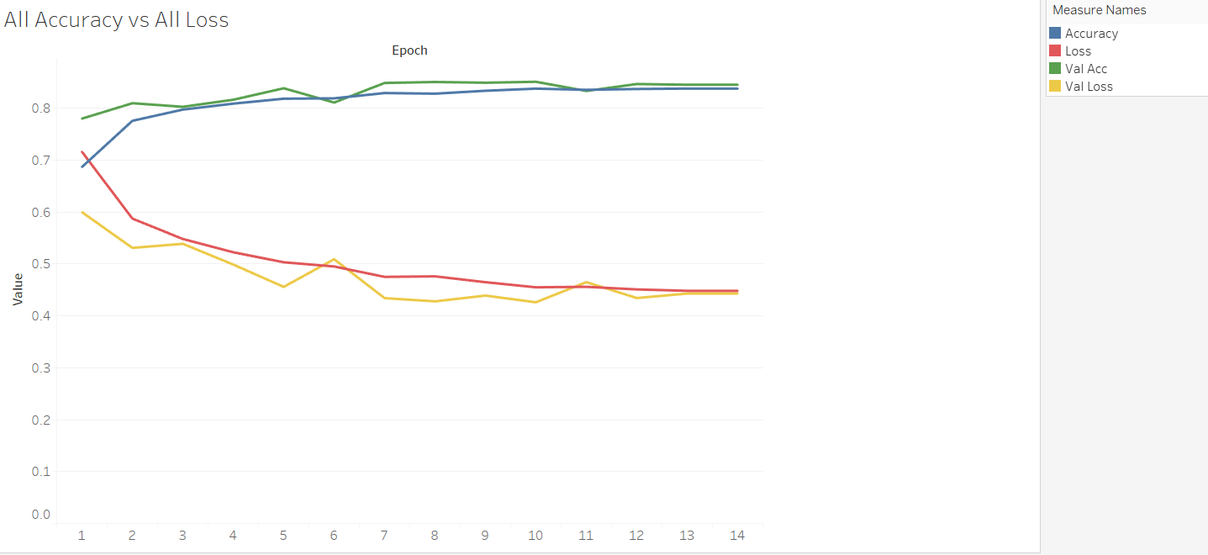
Results
Reference: https://public.tableau.com/profile/kent2848#!/vizhome/ML1Kent/AccandLossStory?publish=yes

Slide 15
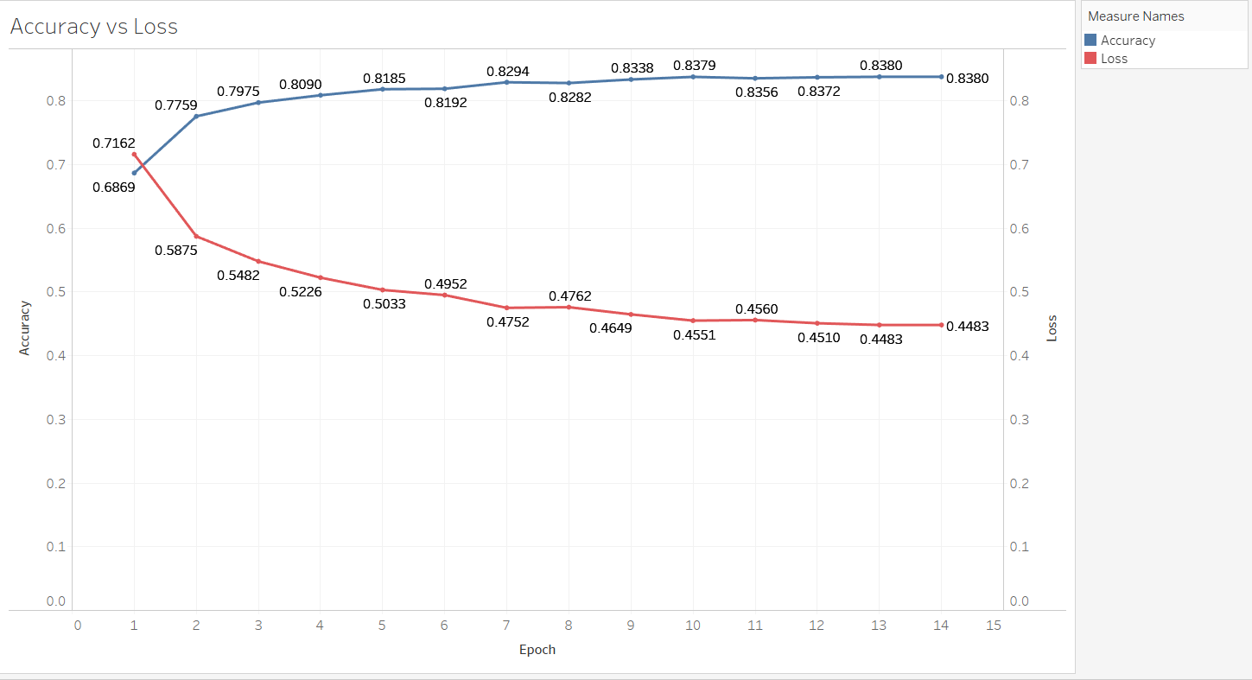
Results

Slide 16
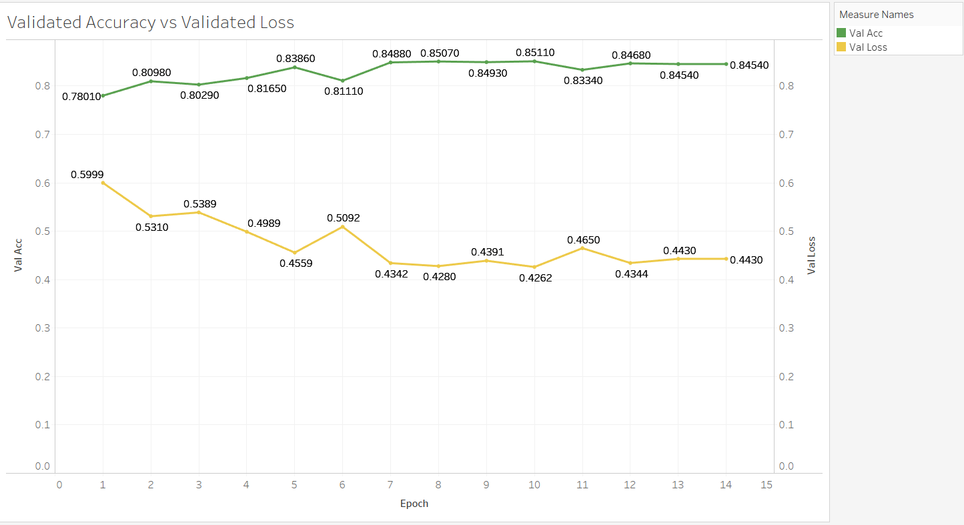
Results

Slide 17
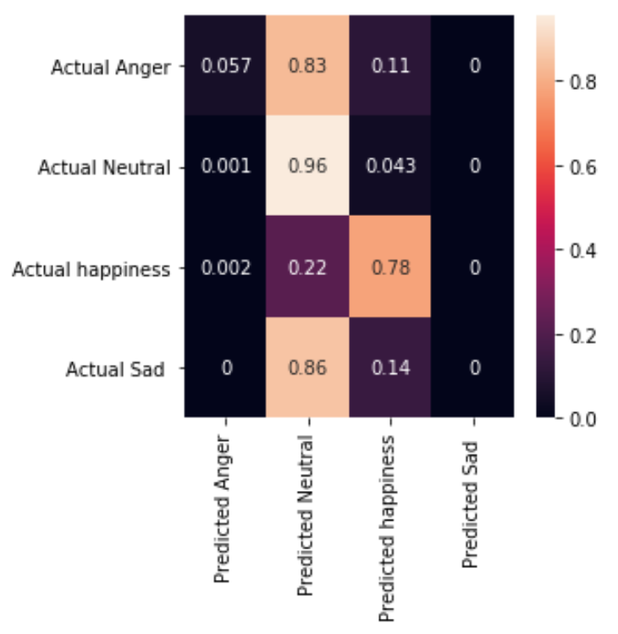
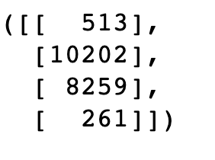
Confusion matrix

Slide 18
Conclusion/Show and Tell
We took a picture from class and ran it through the model !!!
The current model predicts neutral correctly 96% times
It predicts happiness correctly 78% of the time
It is unable to predict sadness and anger with high percentage of accuracy
It predicts anger and sadness as neutral 83% and 86% respectively
As a human it is hard to tell if someone is angry or sad, so it may even be harder to ‘machine learn’
Some social queues in real world situations help us determine expressions in addition to the facial expression

Slide 19
Further Work
Feature Engineering: Expand the image database for additional expressions, additional faces, and additional angles (profile, off center, etc)
A small fraction in the images were anger or sad. The dataset has only 261 Sad images and only 513 Anger images. Many times the anger or sad were labeled as neutral
Need more labeled (Sad and Angry) images

Slide 20
References
https://github.com/muxspace/facial_expressions
https://medium.com/@RaghavPrabhu/understanding-of-convolutional-neural-network-cnn-deep-learning-99760835f148
https://towardsdatascience.com/diy-deep-learning-projects-c2e0fac3274f
http://cs231n.github.io/convolutional-networks/
https://www.linkedin.com/learning/deep-learning-image-recognition

Slide 21
Appendix
Jupyter Notebook
https://github.com/schehrbanokhan/emotion_recognition_neural_network/blob/master/project_emotion_recognition.ipynb
GitHub repository
https://github.com/schehrbanokhan/emotion_recognition_neural_network

Slide 22
Requirements
Pandas
Numpy
Matplotlib
SciKitLearn
Keras
TensorFlow
OPENCV (CV2 )
Tableau

Slide 23
Questions
?

